Slide 1
Bank Network DESIGN
Group 3
Zych, David
Velineni, Hyndavi
Poladi, Sahithi
Meng, Chenghong

Slide 2
Case STUDY OF BANK
National bank with head offices in the big cities (NY, LA, dallas, minneapolis, ..) and several small buildings in major cities in each state. Bank machines all around each city. Total 10000 employees in different cities (1000 in each major city and 100 in each small city around the nation) and over 1000,000 bank accounts (i.E. Users). Employees use a special software to access user accounts, with different levels of access, in addition to the typical servers, mail, web, file servers. Security is crucial in order to secure client accounts.

Slide 3
HOW WE DID
Analyze requirements
Develop the logical design
Develop the physical design
Test, optimize and document the design

Slide 4
Types of servers used
Application server
Fax server
E-mail server
Web server
Print server
Database server
File server
AAA server

Slide 5
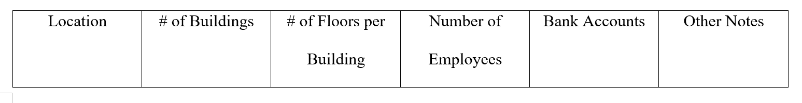
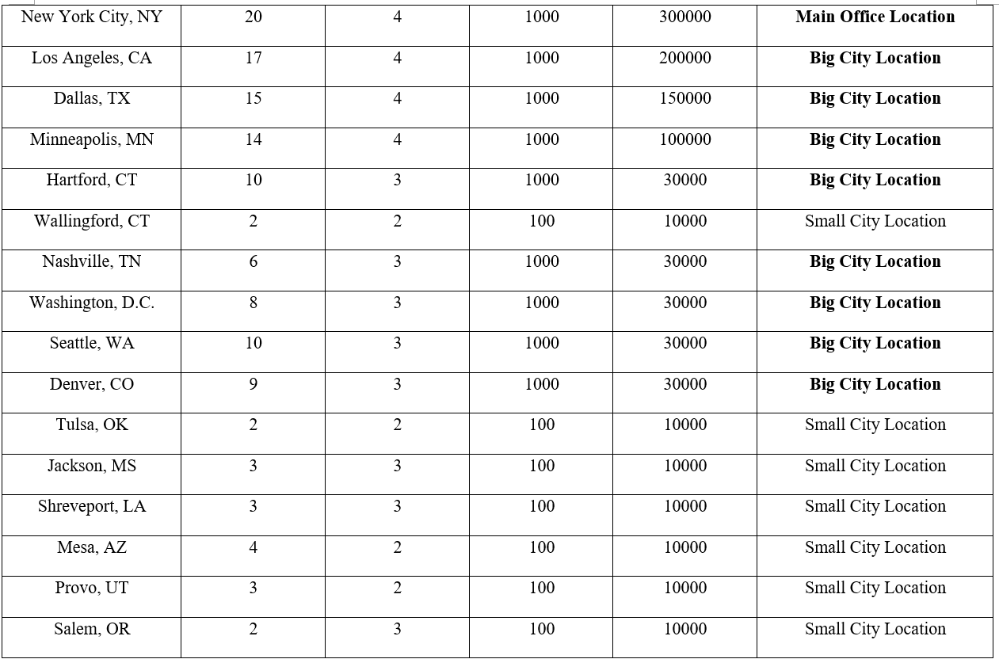
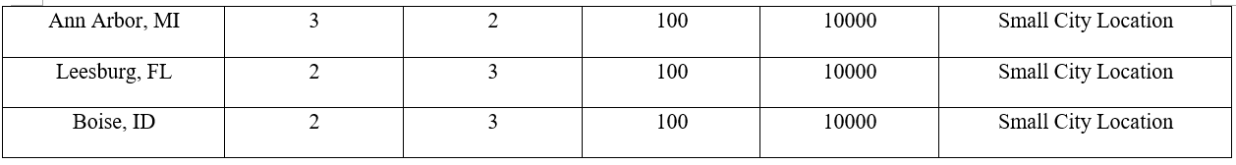

Slide 6
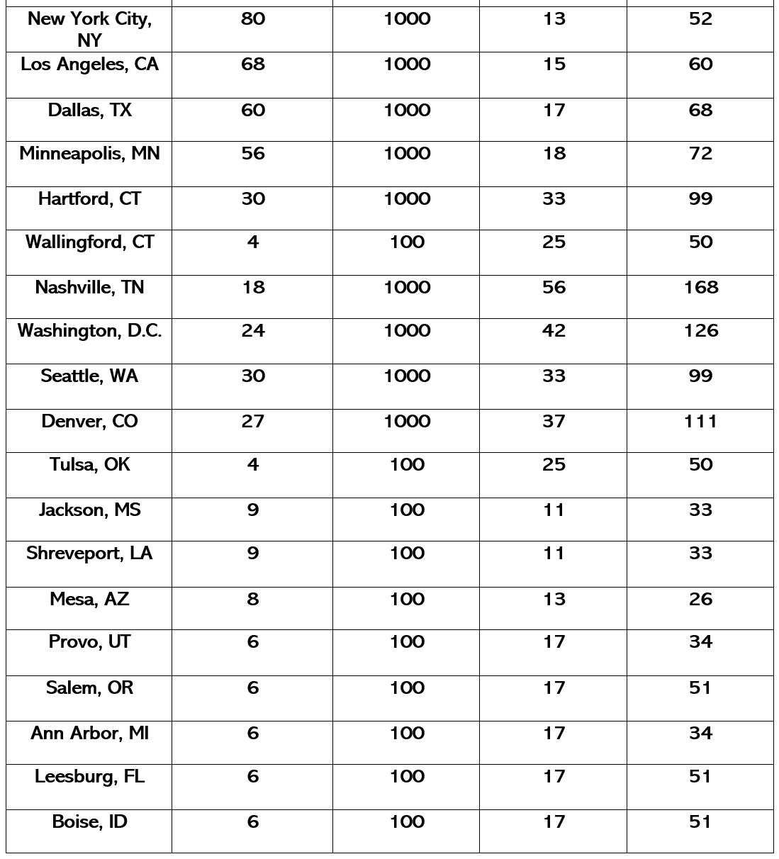

Slide 7
Departments in the bank network
Banking department
Issue department
HR
Currency management department
Exchange control department

Slide 8
Network design topology
Cisco’s hierarchical design model
A core layer of high-end routers and switches that are optimized for availability and speed
A distribution layer of routers and switches that implement policies and segment traffic
An access layer that connects users via hubs, switches, and other devices

Slide 9
addressing
IPv4 Addressing
IP Class: Class B
IP Address: 128.0.0.0
Subnet Mask:255.255.248.0
CIDR value: 21
Usable IP host range: 128.0.0.1 – 128.0.7.254
No of usable hosts for each ip range - 2046

Slide 10
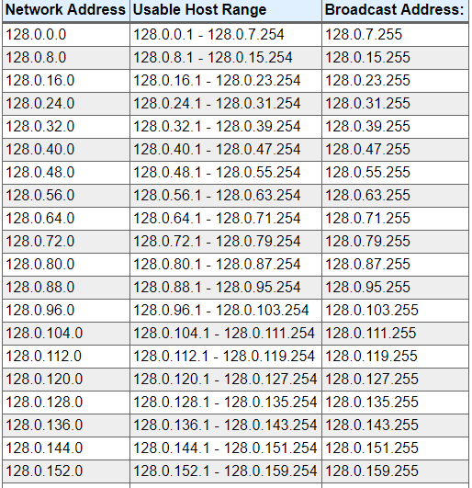

Slide 11
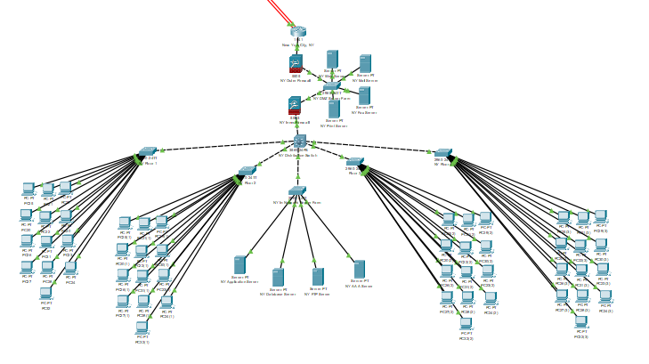
LAN for a big city

Slide 12
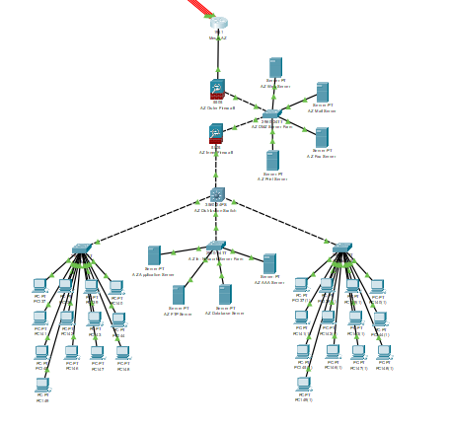
Lan for a small city

Slide 13
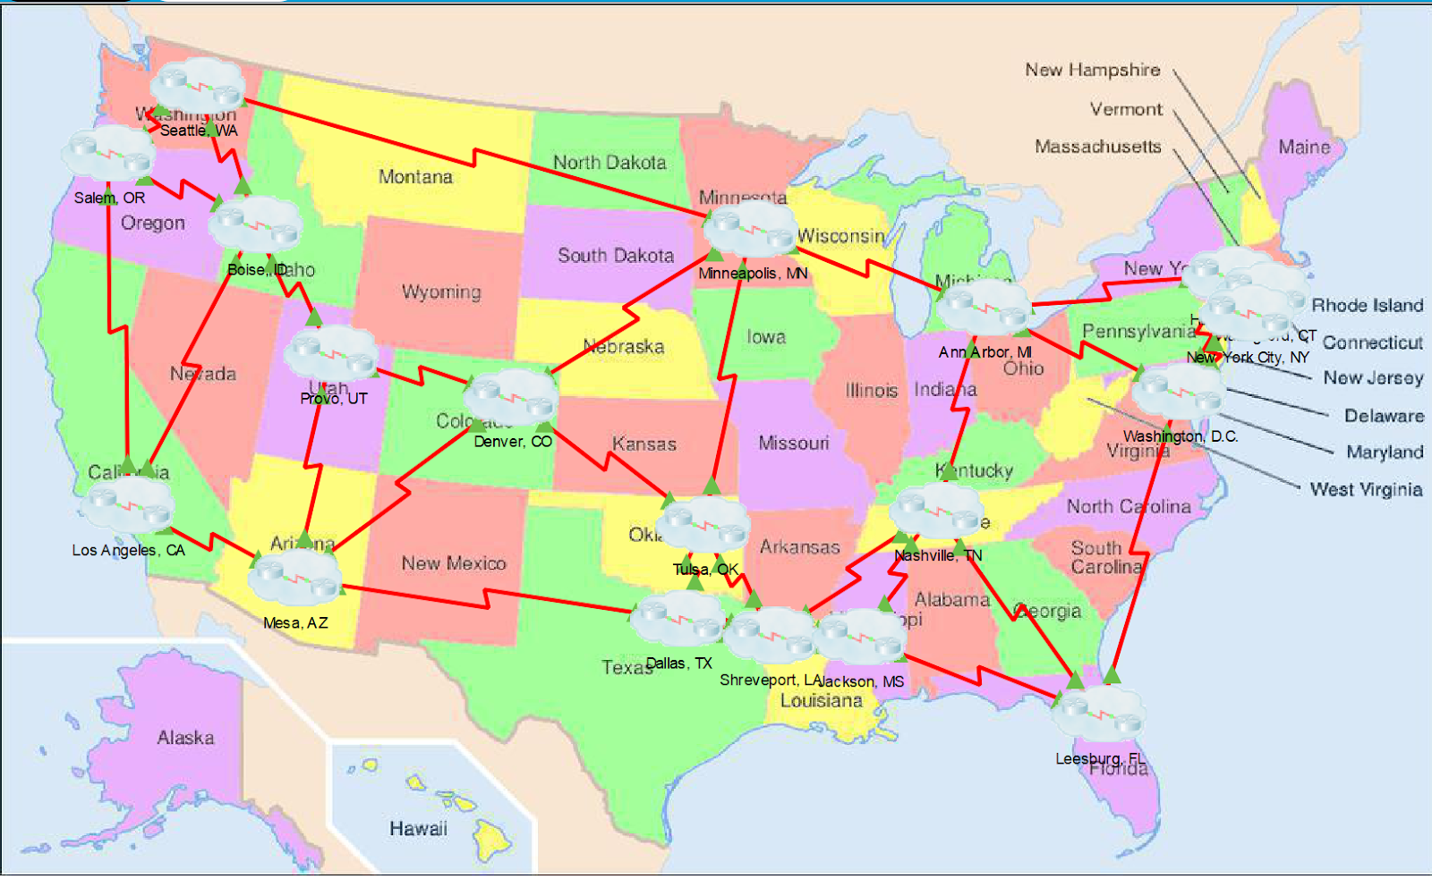
WAN

Slide 14
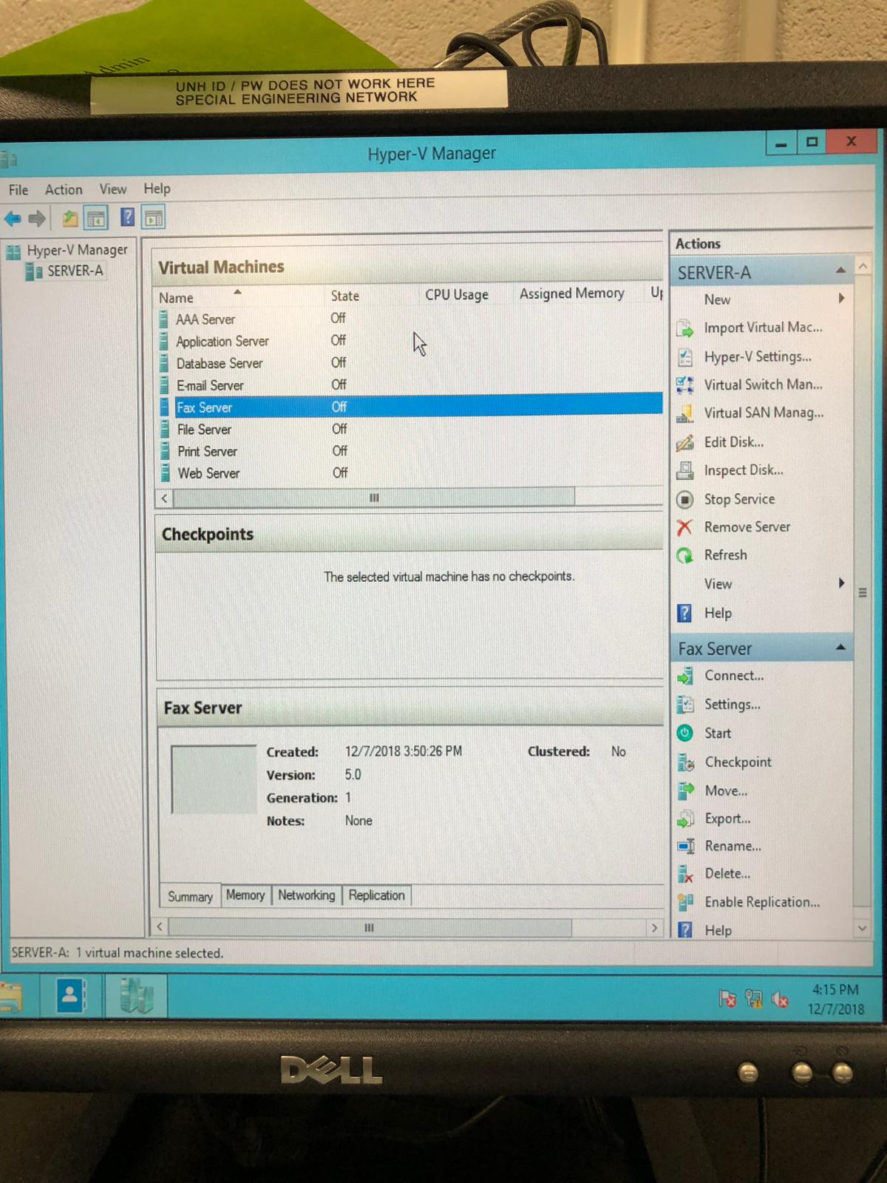
servers

Slide 15
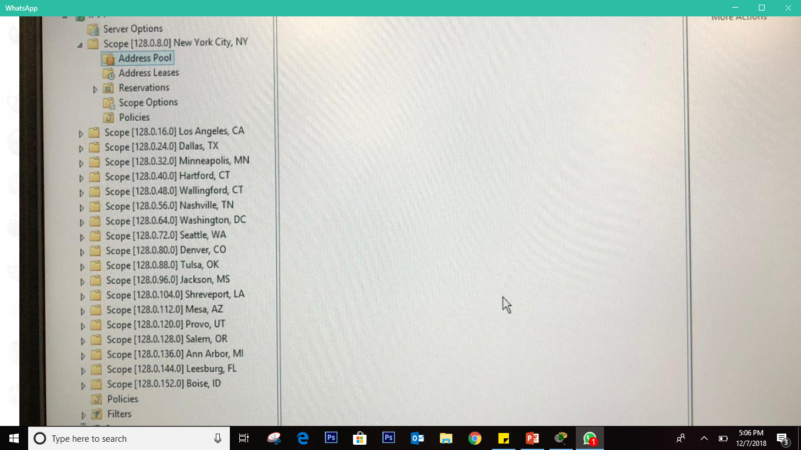
DHCP SCOPE

Slide 16
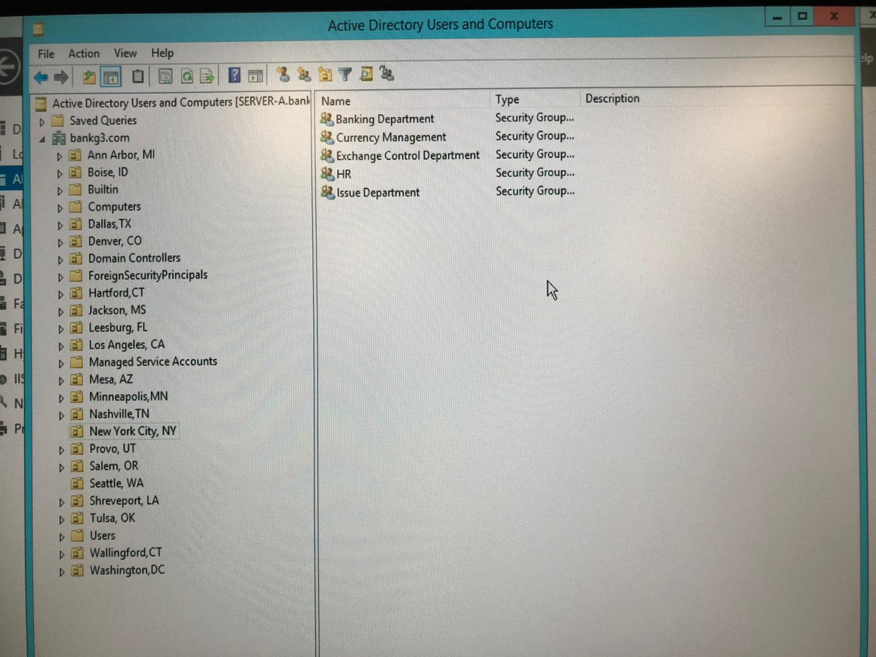
ADDS

Slide 17
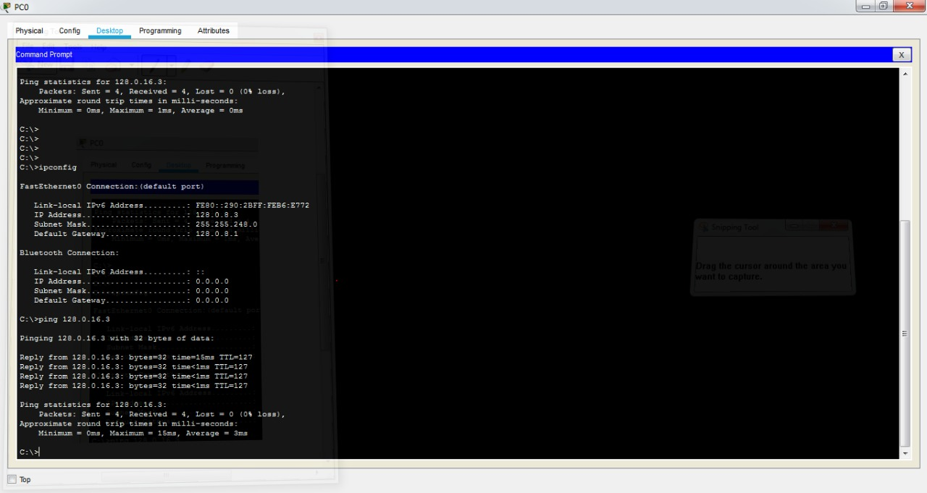
testing

Slide 18
Questions?

